Slide 1
Overview
System Programming in C
Baojian Hua
bjhua@ustc.edu.cn

Slide 2
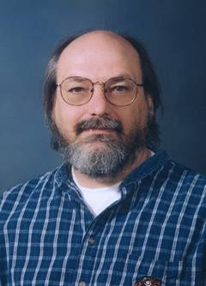
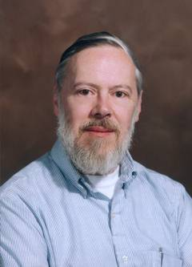
The C Programming Language
Capsule history:
  BCPL → B → C → K&R C → ANSI C → C99
  1960 1970 1972 1978 1988
  LISP → Smalltalk → C++ → Java
  1960’s 1970’s 1980’s 1994
C#
2000
ACM图灵奖得主(1984)：
“在C和Unix上的贡献”

Slide 3
The C Programming Language
C is a system programming language
  Originally invented to write Unix
    later Linux and Windows
  Data types and control structures close to low-level machines
    So you know system deeper, you program better
Pros and cons:
  Can do whatever you want: flexible and powerful
  Can do whatever you do NOT want: shoot yourself in the foot

Slide 4
What is this course about?
System programming in C:
  C is the most widely-used system language
    OS kernels, network stack, compiler, DB, …
  C is low-level
    Device driver, embedded (real-time) system, …
    Closely related with architectures
  Motivating ideas for other languages
    C++/Java/C# etc.

Slide 5
What is this course about?
System interfaces
  POSIX interfaces
    As implemented by almost all operating systems
  And build interesting applications on top of such interfaces

Slide 6
Course Topics
50’-60’:
Programming languages
60’-70’:
Uni-processor
70’-80’:
Networking
90’-00’:
Multi-core
00’-10’:
Cloud
10’-~:
AI
…
Topics:
single user, single process
Topics:
multi-process
Topics:
Networking programming
Topics:
Concurrency
Topics:
Distribution
Topics:
Heterogenous

Slide 7
Goal of this course
Solid C programming skills
  C is crucial for CS
  Foundations for later computer courses
System programming skills
  Be experienced system programmers
Familiarize you with computational thinking
  e.g., abstraction (ADT), polymorphism, recursion

Slide 8
How this course works?

Slide 9
Administrivia
Instructors:
  Hua, Baojian
  Fan, Qiliang

Slide 10
Course Home Page
Home page
https://csslab-ustc.github.io/courses/sysprog/
  Course administrivia
  Lecture notes
  Labs
  Resources
Check course home page frequently

Slide 11
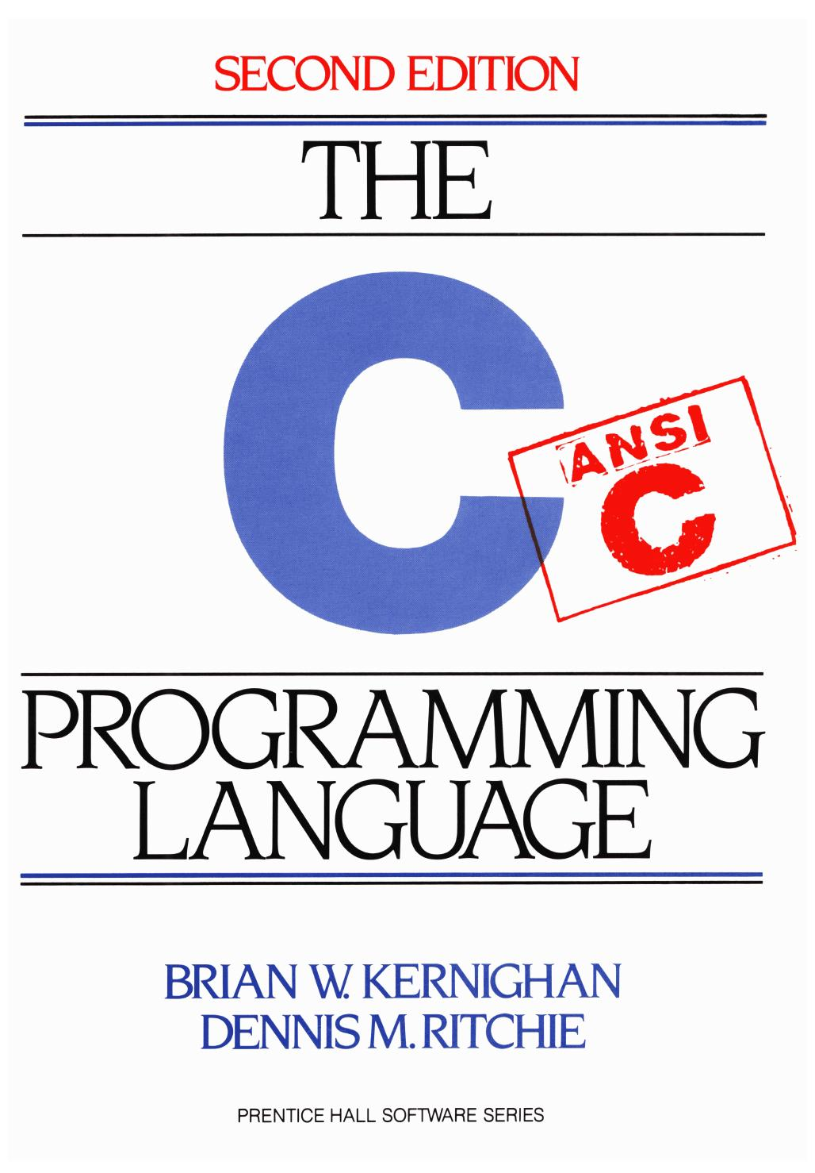
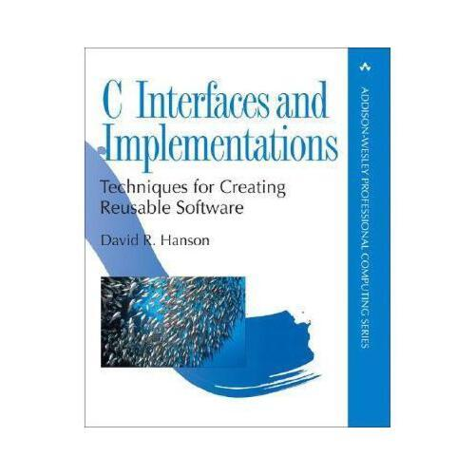
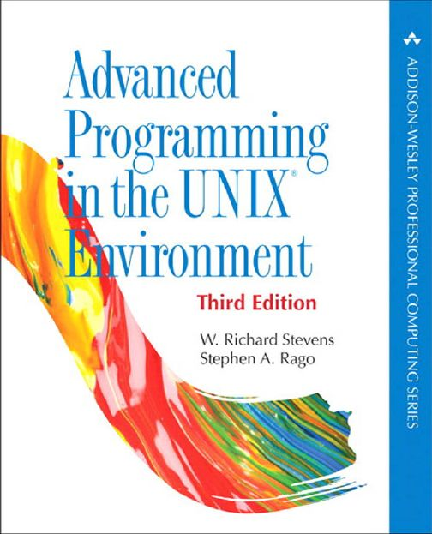
Textbooks and References
The C Programming Language (2nd Edition) . Kernighan and Ritchie, 1988.
C Interface and Implementation, 2002.
Unix System Programming. Richard Stevens.

Slide 12
Labs
There are 6 labs (Optional this year)
  Each consists of some required problems and optional problems
    Optional assignments are not required, but highly recommended
  Solve them independently
  Late homework will not be accepted

Slide 13
Labs
No. | Topic | Goal
0 | Software setup | Install the required tools
1 | Compiler | Learn single-process programming
2 | Shell | Learn multi-process programming
3 | Concurrent Objects | Learn multi-threaded concurrent programming
4 | Network sniffer | Learn socket programming
5 | MapReduce | Learn distributed programming
6 | Debugger | Learn software security and analysis

Slide 14
Test and Evaluation
No test :-)
Scores:
  50%: homework (all problems in TCPL)
  50%: final writing and submission
No one should fail!

Slide 15
Learning by Doing
Get your hands dirty

Slide 16
Any questions?

