Slide 1
Verification condition
Formal Methods Foundation
Baojian Hua
bjhua@ustc.edu.cn

Slide 2
Recap
To prove Hoare logic assertions manually requires considerable engineering efforts
  To construct the proof trees
Can we develop an automatic strategy to prove Hoare logic assertions?
  The answer is affirmative
  This is the verification condition, today’s topic

Slide 3

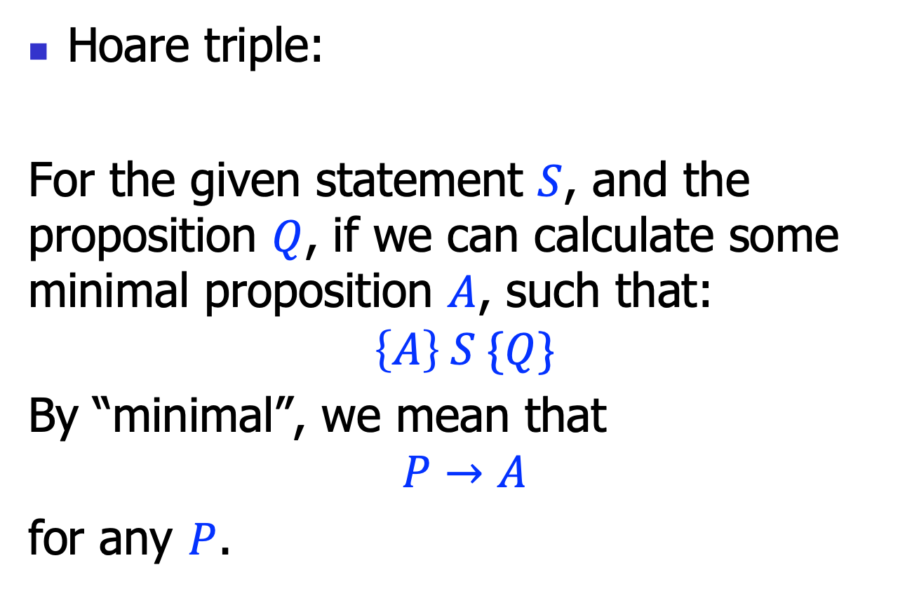
Motivation
Hoare triple:
For the given statement $S$, and the proposition $Q$, if we can calculate some minimal proposition $A$, such that:
$$\left\{A\right\} S \{Q\}$$
By “minimal”, we mean that
$$P→A$$
for any $P$.
$$\left\{P\right\} S \{Q\}$$

Slide 4

Weakest pre-condition
Such a proposition $A$ is called a weakest pre-condition (due to Dijkstra)
weakest (True)
strongest (False)
region for P
weakest pre-condition
We write the weakest pre-condition WP(S, Q), with the statement $S$ and the post-condition $Q$ as inputs.
Key problem: how to calculate the weakest pre-condition WP(S, Q), for a Hoare triple $\left\{P\right\} S \{Q\}$?

Slide 5
Architecture
verified/
wrong
programs
weakest pre-condition
generator
propositions
prover/
solver

Slide 6
Weakest pre-condition generation

Slide 7
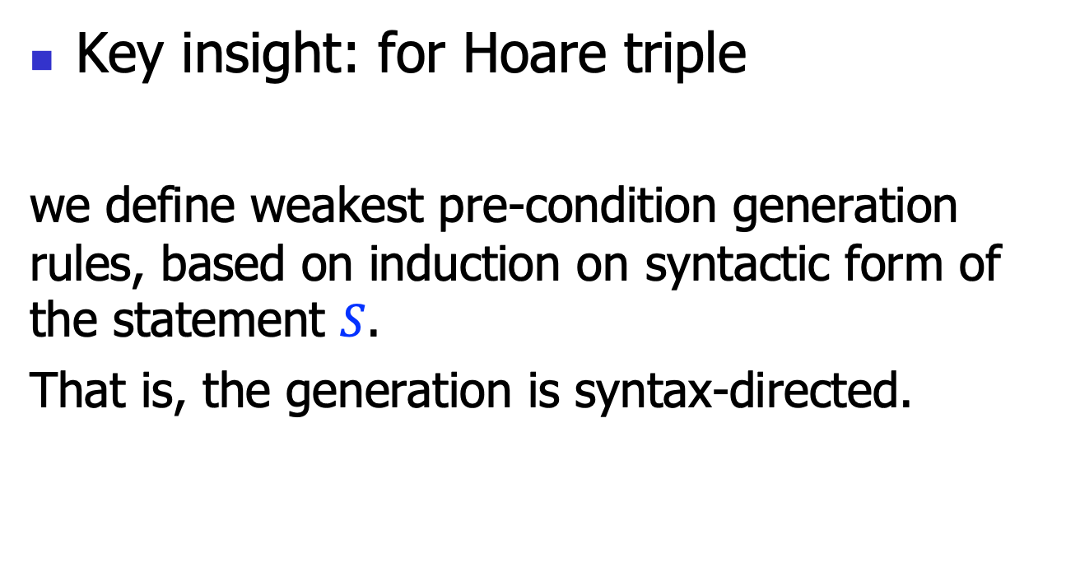
Syntax directed rules
Key insight: for Hoare triple
we define weakest pre-condition generation rules, based on induction on syntactic form of the statement $S$.
That is, the generation is syntax-directed.
$$\left\{P\right\} S \{Q\}$$

Slide 8



WP generation rules: empty
$$(H−Skip)$$
$$\left\{P\right\}skip\{P\}$$
$$WP(skip, P)=P$$
Example:
$$WP\left(skip, x>k\right)=x>k$$

Slide 9



WP generation rules: assignment
$$(H−Assign)$$
$$\left\{P[x↦E]\right\}x=E\{P\}$$
$$WP\left(x=E, P\right)=P[x↦E]$$
Example:
$$WP\left(x=y+z, x>k\right)=y+z>k$$

Slide 10

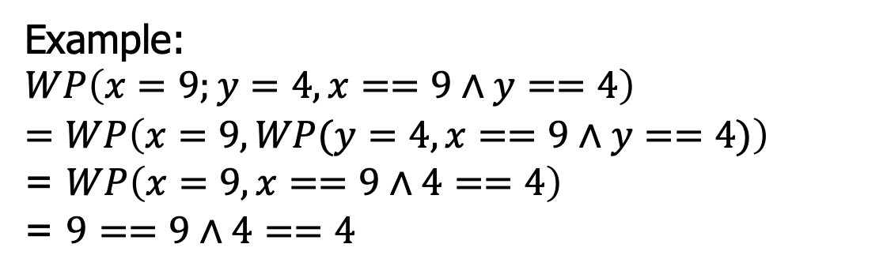



Hoare logic rules: sequence
$$\left\{P\right\}S1\{R\}$$
$$\left\{R\right\}S2\{Q\}$$
$$(H−Seq)$$
$$\left\{P\right\} S1;S2 \{Q\}$$
$$WP\left(S1;S2, Q\right)=WP(S1,WP\left(S2, Q)\right)$$
Example:
$$WP\left(x=9;y=4,x==9∧y==4\right)$$
$$=WP\left(x=9, WP(y=4,x==9∧y==4)\right)$$
= $WP\left(x=9, x==9∧4==4\right)$
= $9==9∧4==4$

Slide 11

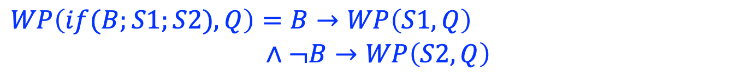

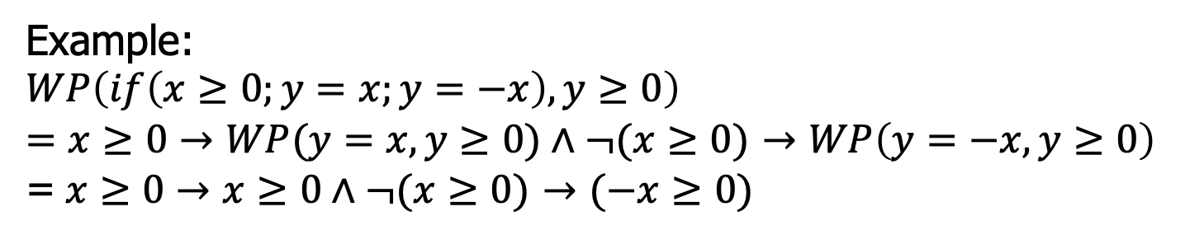


Hoare logic rules: if
$$\left\{P∧B\right\}S1\{Q\}$$
$$\left\{P∧¬B\right\}S2\{Q\}$$
$$(H−If)$$
$$\left\{P\right\}if\left(B;S1;S2\right)\{Q\}$$
$$WP\left(if(B;S1;S2), Q\right)=B→WP\left(S1,Q\right)$$
$∧¬B→WP\left(S2,Q\right)$
Example:
$$WP\left(if\left(x≥0;y=x;y=−x\right), y≥0\right)$$
$=x≥0→WP(y=x, y≥0)∧¬(x≥0)$ $→WP\left(y=−x, y≥0\right)$
=$x≥0→x≥0∧¬(x≥0)$ $→(−x≥0)$

Slide 12


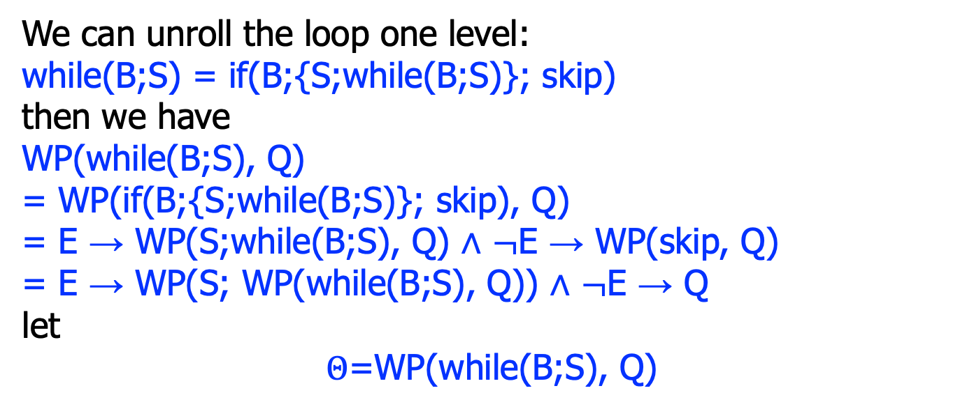

Hoare logic rules: while
$$\left\{I∧B\right\}S\{I\}$$
$$(H−While)$$
$$\left\{I\right\}while(B;S)\{I∧¬B\}$$
We can unroll the loop one level:
while(B;S) = if(B;{S;while(B;S)}; skip)
then we have
WP(while(B;S), Q)
= WP(if(B;{S;while(B;S)}; skip), Q)
= E → WP(S;while(B;S), Q) ∧ $¬$E → WP(skip, Q)
= E → WP(S; WP(while(B;S), Q)) ∧ $¬$E → Q
let
$Θ$=WP(while(B;S), Q)

Slide 13
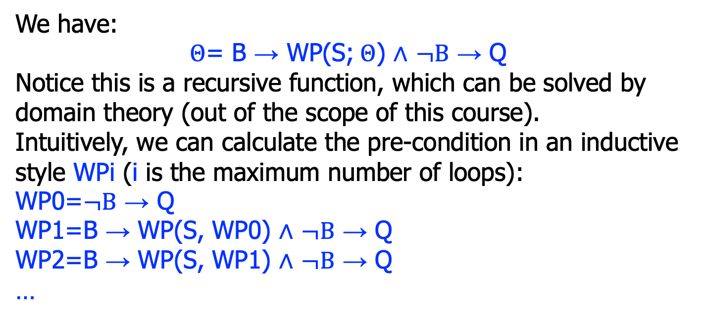
Hoare logic rules: while
$$\left\{I∧B\right\}S\{I\}$$
$$(H−While)$$
$$\left\{I\right\}while(B;S)\{I∧¬B\}$$
We have:
$Θ$= B → WP(S;$Θ$) ∧ $¬B$ → Q
Notice this is a recursive function, which can be solved by domain theory (out of the scope of this course).
Intuitively, we can calculate the pre-condition in an inductive style WPi (i is the maximum number of loops):
WP0=$¬B$ → Q
WP1=B → WP(S, WP0) ∧ $¬B$ → Q
WP2=B → WP(S, WP1) ∧ $¬B$ → Q
…

Slide 14
Hoare logic rules: while
$$\left\{I∧B\right\}S\{I\}$$
$$(H−While)$$
$$\left\{I\right\}while(B;S)\{I∧¬B\}$$
We have:
WP=WP0 ∧ WP1 ∧ WP2 ∧ …
So, practically, this is not computable (in general).

Slide 15
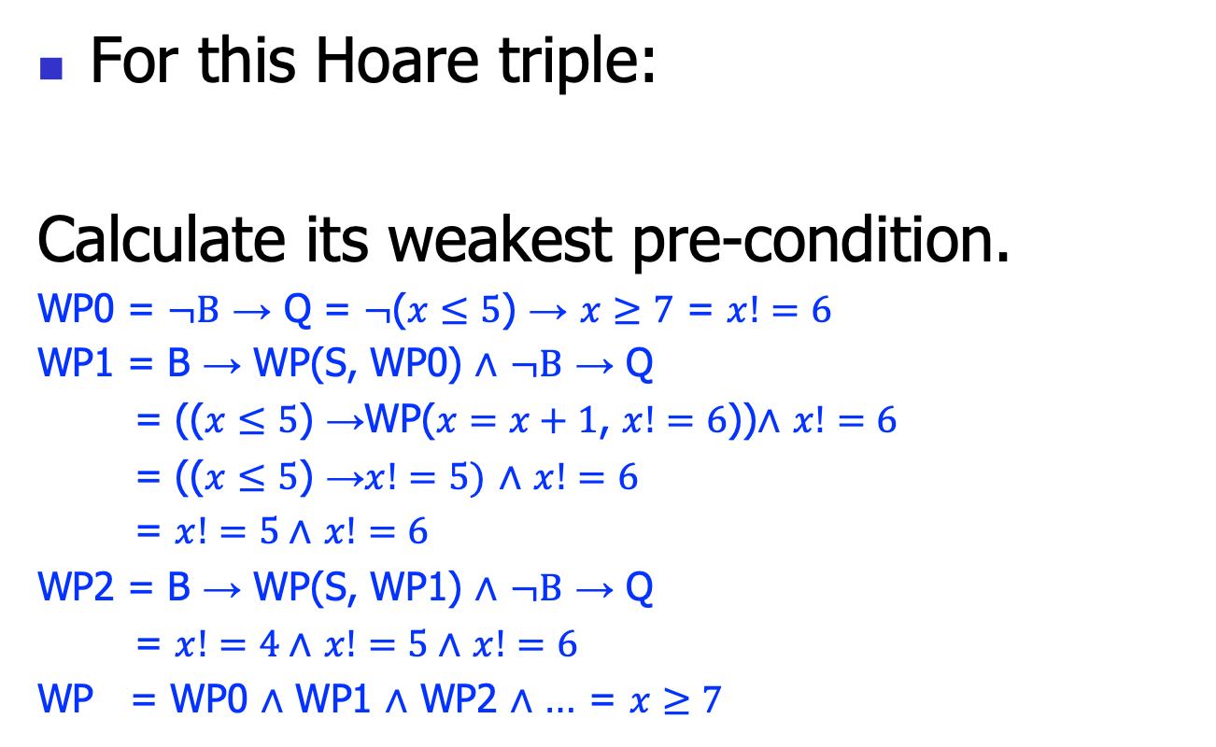
Weakest pre-condition example #1
For this Hoare triple:
Calculate its weakest pre-condition.
WP0 = $¬B$ → Q = $¬$($x≤5$) → $x≥7$ = $x!=6$
WP1 = B → WP(S, WP0) ∧ $¬B$ → Q
= (($x≤5$) →WP($x=x+1$, $x!=6$))∧ $x!=6$
= (($x≤5$) →$x!=5)$ ∧ $x!=6$
= $x!=5$∧ $x!=6$
WP2 = B → WP(S, WP1) ∧ $¬B$ → Q
= $x!=4$∧ $x!=5$∧ $x!=6$
WP = WP0 ∧ WP1 ∧ WP2 ∧ … = $x≥7$
$$\left\{??\right\} while(x≤5;x=x+1) \{x≥7\}$$

Slide 16
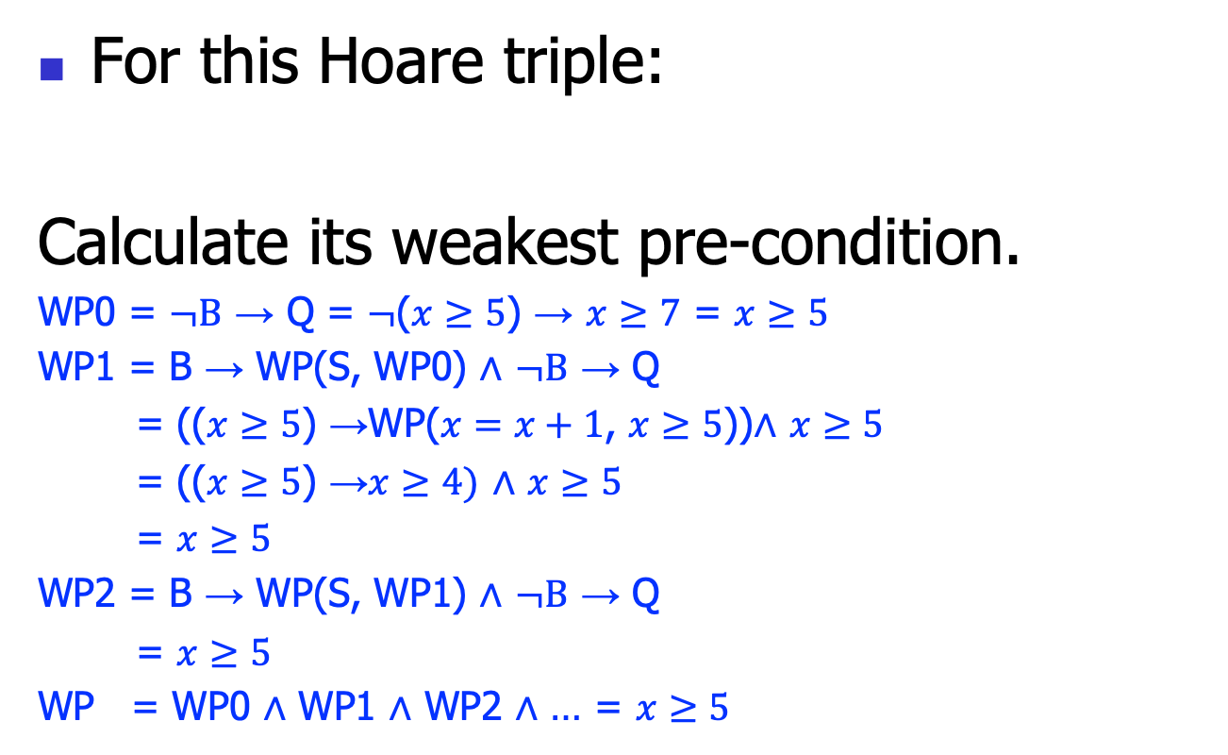
Weakest pre-condition example #2
For this Hoare triple:
Calculate its weakest pre-condition.
WP0 = $¬B$ → Q = $¬$($x≥5$) → $x≥7$ = $x≥5$
WP1 = B → WP(S, WP0) ∧ $¬B$ → Q
= (($x≥5$) →WP($x=x+1$, $x≥5$))∧ $x≥5$
= (($x≥5$) →$x≥4)$ ∧ $x≥5$
= $x≥5$
WP2 = B → WP(S, WP1) ∧ $¬B$ → Q
= $x≥5$
WP = WP0 ∧ WP1 ∧ WP2 ∧ … = $x≥5$
$$\left\{??\right\} while(x≥5;x=x+1) \{x≥7\}$$

Slide 17
Moral
The calculation of weakest pre-condition is not practical in general
  infinite calculations
To make the calculation practical, we must introduce more practical techniques
  One is the verification condition

Slide 18
Verification Condition

Slide 19

Verification condition
We want to find out a verification condition $VC$:
Verification
condition
weakest (True)
strongest (False)
P
weakest pre-condition
We hope the VC to have two nice properties: 1) easy to calculate than the weakest pre-condition; and 2) still weaker than the given pre-condition.
Key problem: how to calculate verification condition VC(S, Q), for a Hoare triple $\left\{P\right\} S \{Q\}$?

Slide 20
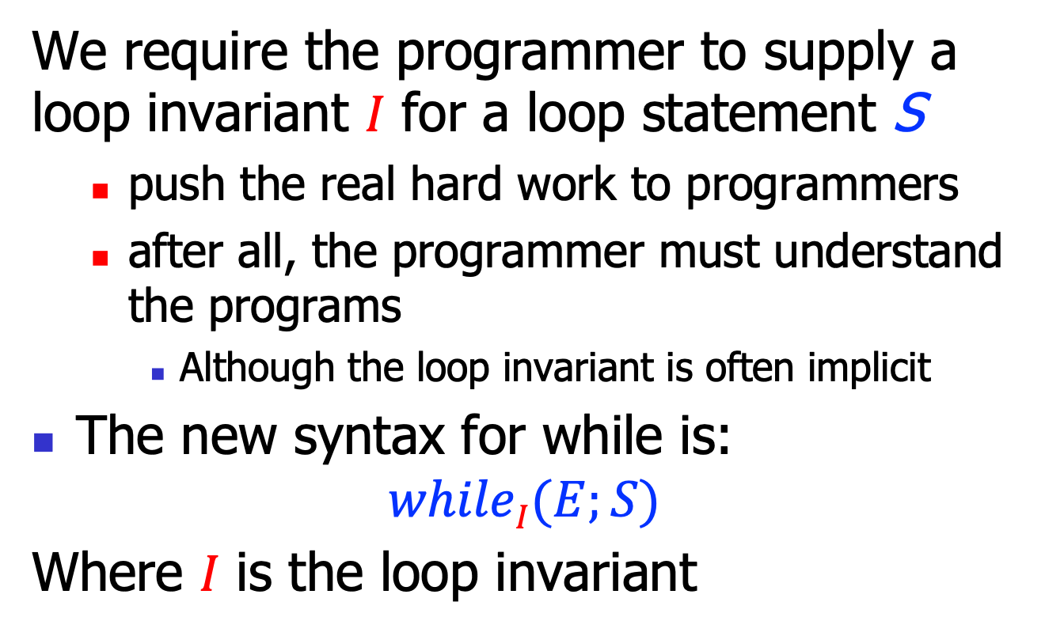
Key insight
We require the programmer to supply a loop invariant 𝐼 for a loop statement S
  push the real hard work to programmers
  after all, the programmer must understand the programs
    Although the loop invariant is often implicit
The new syntax for while is:
$$whileI(E;S)$$
Where 𝐼 is the loop invariant

Slide 21
Invariant example
This is always good engineering practice
  though not always in a rigorous form
    for example: program comments
  Loop invariants are one of the hardest parts in verification
{n>=0}
sum(n){
s = 0;
i = 0;
{i<=(n+1)/\
2*s==(i-1)*i}
while(i<=n){
s=s+i;
i=i+1;
}
}
{2*s==n*(n+1)}

Slide 22
Verification condition generation
With these annotations, we design a set of rules to generate the verification conditions for a Hoare triple {P}S{Q}
  VC(S, Q)
These rule is also syntax-directed
  Based on the induction of syntactic forms of the statement S

Slide 23
Architecture
verified/
wrong
programs
verification
condition
generator
propositions
prover/
solver

Slide 24

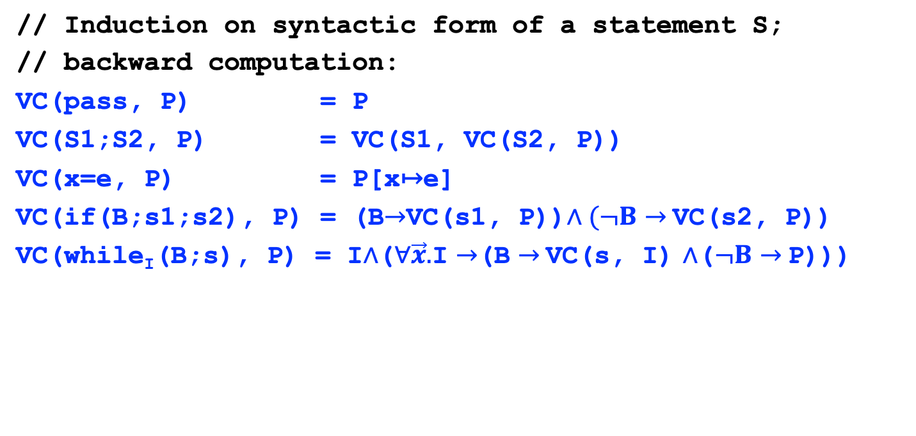
Verification condition generation algorithms
// Induction on syntactic form of a statement S;
// backward computation:
VC(pass, P) = P
VC(S1;S2, P) = VC(S1, VC(S2, P))
VC(x=e, P) = P[x↦e]
VC(if(B;s1;s2), P) = (B$→$VC(s1, P))$∧(¬B$ $→$VC(s2, P))
VC(while_{I}(B;s), P) = I∧($∀\vec{x}.$I $→$(B $→$VC(s, I) ∧($¬B$ $→$P)))
Loop invariant I must hold before entering the loop.
$\vec{x}$ is a set of variables being assigned to in the while body.
If loop invariant I and while condition e hold, I holds after the loop.
While condition e does not hold.

Slide 25

Verification condition generation algorithms, cont’
// For function, take into account both pre- and post-
// conditions:
VC(pre f(){S} post) = pre $→$ VC(S, post)
// the final VC is the candidate to prove or disprove.

Slide 26
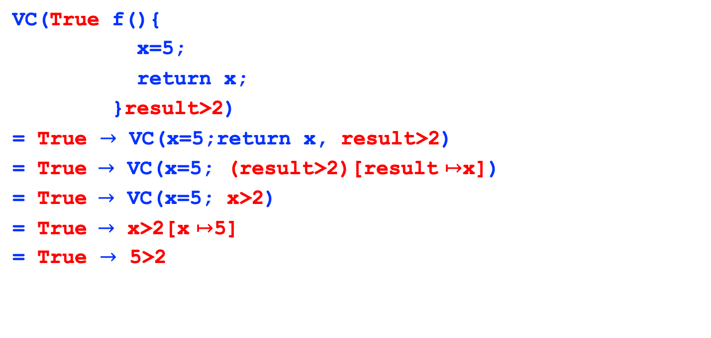
VC generation example 1
VC(True f(){
x=5;
return x;
}result>2)
= True $→$ VC(x=5;return x, result>2)
= True $→$ VC(x=5; (result>2)[result $↦$x])
= True $→$ VC(x=5; x>2)
= True $→$ x>2[x $↦$5]
= True $→$ 5>2

Slide 27
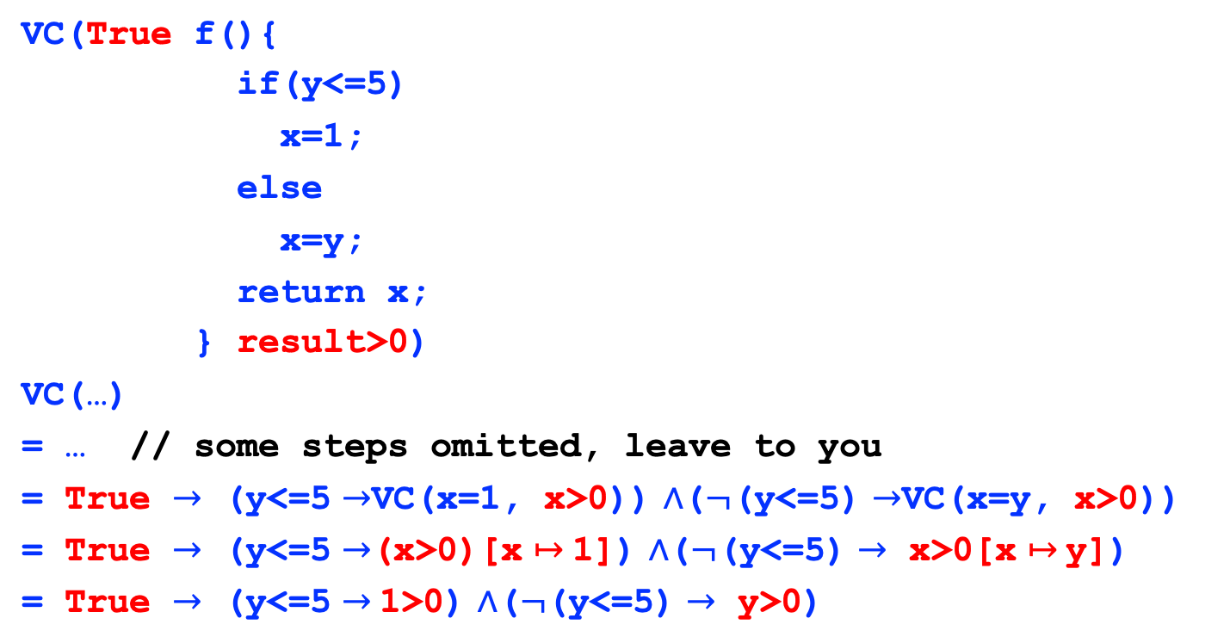
VC generation example 2
VC(True f(){
if(y<=5)
x=1;
else
x=y;
return x;
} result>0)
VC(…)
= … // some steps omitted, leave to you
= True $→$ (y<=5 $→$VC(x=1, x>0)) ∧($¬$(y<=5) $→$VC(x=y, x>0))
= True $→$ (y<=5 $→$(x>0)[x $↦$1]) ∧($¬$(y<=5) $→$ x>0[x $↦$y])
= True $→$ (y<=5 $→$1>0) ∧($¬$(y<=5) $→$ y>0)

Slide 28
VC generation example 3
VC(n>=0 sum(n){
s=0;
i=0;
while(i<=n)
inv={i<=(n+1)/\2*s==(i-1)*i}
{
s=s+i;
i=i+1;
}
return s;}
2*result==n*(n+1))
= … // leave to you as an exercise

Slide 29
VC explosion
4*Q
2*Q
2*Q
VC(True foo(x, y){
if(x<1) y=y+1; else y=y+2;
if(x<2) y=y+2; else y=y+3;
if(x<3) y=y+3; else y=y+4;
return y;
}
result>0)
= … // leave to you as exercise
2*Q
Q
Q
Q

Slide 30
Forward calculation of
Verification Conditions

Slide 31
Forward VC generation
The VC generation we’ve discussed is backward
  Suitable for the structured languages
The VC generation can also be performed in a forward style
  Suitable even for unstructured languages
    Say IR or even assembly
    Also more flexible
Use symbolic execution

Slide 32
An intermediate language
O ::= + | - | * | /
E ::= n | x | E O E
B ::= E==E | E!=E | B&&B | B||B | !B
S ::= skip // empty
| x=E // assignment
| L: // label
| inv B // an invariant E
| f(E1, …, En) // function call
| if(B, L1, L2) // branching
| goto L // jump
| return E // function return
F ::= f(x1, …, xn){S*;}

Slide 33
Example
{x<=0}
f(x){
{x<=5}
while(x<5){
x = x+1;
}
return x;
}
{result==5}
{x<=0}
f(x){
L:
inv {x<=5}
if(x<5, L1, L2)
L1:
x = x+1
goto L
L2:
return x;
}
{result==5}

Slide 34
Recall the language IMP
O ::= + | - | * | / | == | != | > | < | >= | <=
E ::= n | x | E O E
B ::= E==E | E!=E | B&&B | B||B | !B
S ::= skip
| x=E
| S;S
| f(E1, …, En)
| if(E, S, S)
| while(E, S)
F ::= f(x1, …, xn){S; return E;}

Slide 35

The compilation
$⟦\text{skip}⟧$ = skip
$⟦\text{x}\text{=}\text{E}⟧$ = x=E
$⟦\text{f}\text{(}\text{E}\text{1,} \text{…,} \text{En}\text{)}⟧$ = f(E1, …, En)
$⟦\text{if}\text{(}\text{B}\text{,} \text{S}\text{,} \text{S}\text{)}⟧$ = if(B, L1, L2)
L1:
$⟦S1⟧$
goto L3
L2:
$⟦S2⟧$
goto L3
L3:

Slide 36

The compilation, cont’
$⟦\text{while}\text{I}\text{(}\text{B}\text{;}\text{S}\text{)}⟧$ = L:
inv I
if(B, L1, L2)
L1:
$⟦\text{S}⟧$
goto L
L2:

Slide 37
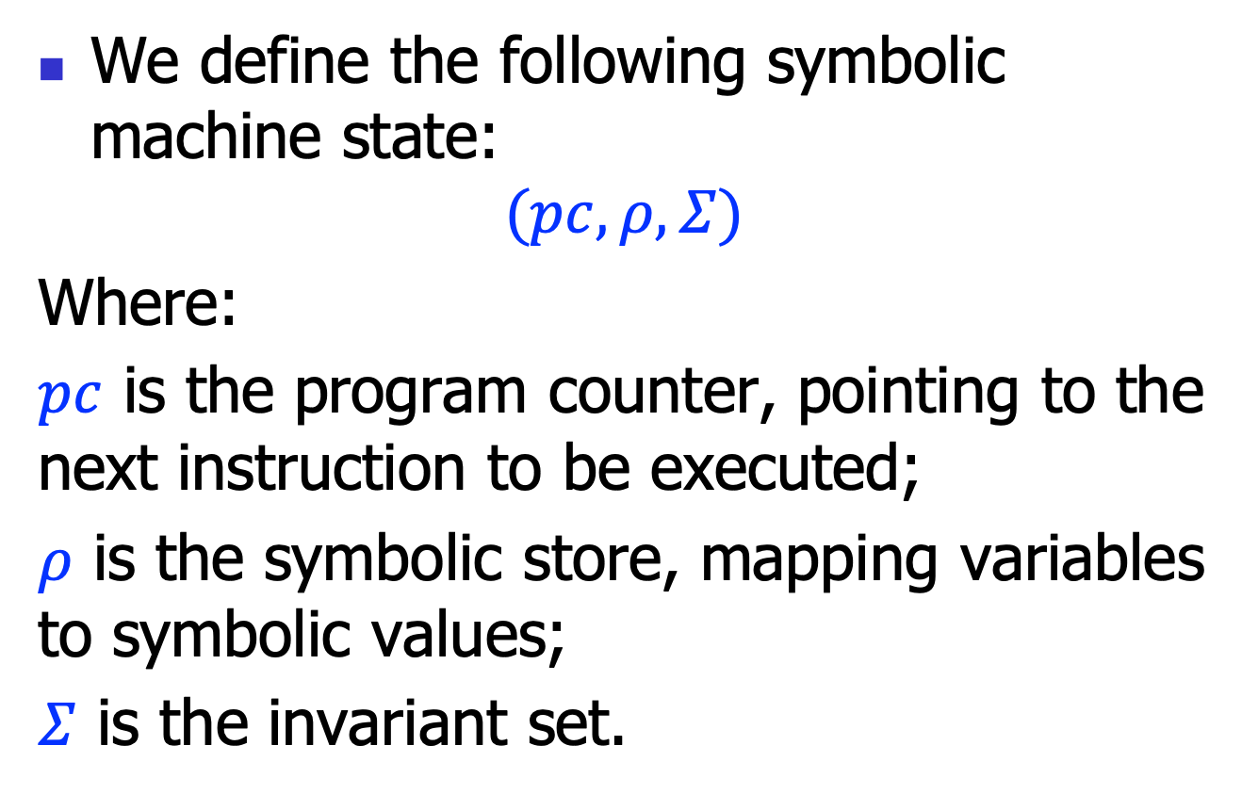
The symbolic machine
We define the following symbolic machine state:
$$(pc,ρ,Σ)$$
Where:
$pc$ is the program counter, pointing to the next instruction to be executed;
$ρ$ is the symbolic store, mapping variables to symbolic values;
$Σ$ is the invariant set.

Slide 38
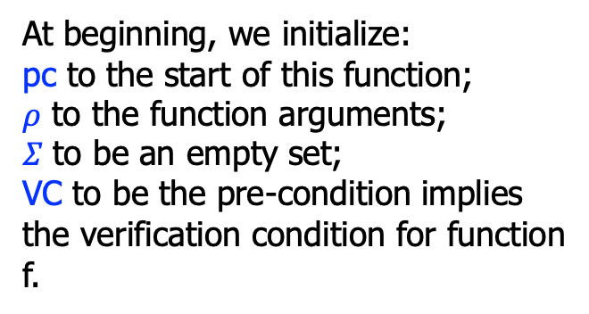
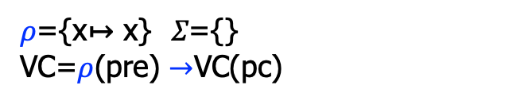
Example
{x<=0}
f(x){
L:
inv {x<=5}
if(x<5, L1, L2)
L1:
x = x+1
goto L
L2:
return x;
}
{result==5}
$ρ$={x↦ x} 𝛴={}
VC=$ρ$(pre) $→$VC(pc)
pc
At beginning, we initialize:
pc to the start of this function;
$ρ$ to the function arguments;
𝛴 to be an empty set;
VC to be the pre-condition implies the verification condition for function f.

Slide 39
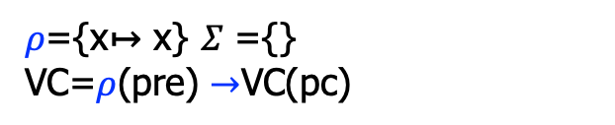
Example
{x<=0}
f(x){
L:
inv {x<=5}
if(x<5, L1, L2)
L1:
x = x+1
goto L
L2:
return x;
}
{result==5}
$ρ$={x↦ x} 𝛴 ={}
VC=$ρ$(pre) $→$VC(pc)
pc
For a label L, we just continue.

Slide 40
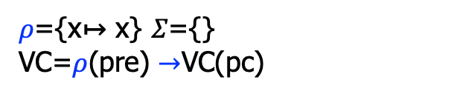
Example
{x<=0}
f(x){
L:
inv {x<=5}
if(x<5, L1, L2)
L1:
x = x+1
goto L
L2:
return x;
}
{result==5}
$ρ$={x↦ x} 𝛴={}
VC=$ρ$(pre) $→$VC(pc)
pc
For an invariant inv, we check whether it appears in the invariant set 𝛴:
1. If no (we see the inv for the first time): add inv to the invariant set, and continue;
2. if yes (we have already saw the inv): just skip.

Slide 41
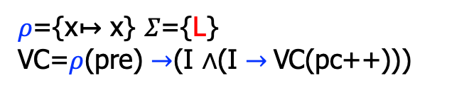
Example
{x<=0}
f(x){
L:
inv {x<=5}
if(x<5, L1, L2)
L1:
x = x+1
goto L
L2:
return x;
}
{result==5}
$ρ$={x↦ x} 𝛴={L}
VC=$ρ$(pre) $→$(I ∧(I $→$VC(pc++)))
pc
For an invariant inv, we check whether it appears in the invariant set 𝛴:
1. If no (we see the inv for the first time): add inv to the invariant set, and continue;
2. if yes (we have already saw the inv): just skip.

Slide 42
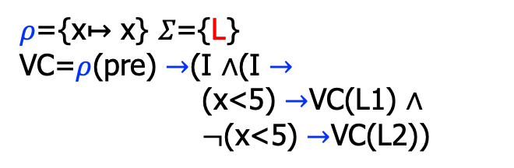
Example
{x<=0}
f(x){
L:
inv {x<=5}
if(x<5, L1, L2)
L1:
x = x+1
goto L
L2:
return x;
}
{result==5}
$ρ$={x↦ x} 𝛴={L}
VC=$ρ$(pre) $→$(I ∧(I $→$
(x<5) $→$VC(L1) ∧
$¬$(x<5) $→$VC(L2))
pc
For branching if, we continue with the true and false branches.

Slide 43
Example
{x<=0}
f(x){
L:
inv {x<=5}
if(x<5, L1, L2)
L1:
x = x+1
goto L
L2:
return x;
}
{result==5}
$ρ$={x↦ x} 𝛴={L}
VC=$ρ$(pre) $→$(I ∧(I $→$
(x<5) $→$VC(L1) ∧
$¬$(x<5) $→$VC(L2))
pc
For an label L, we continue.

Slide 44
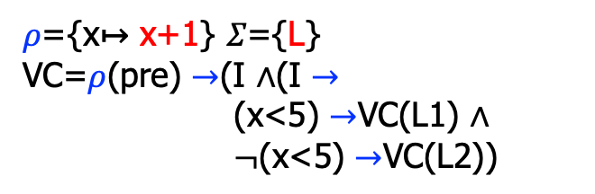
Example
{x<=0}
f(x){
L:
inv {x<=5}
if(x<5, L1, L2)
L1:
x = x+1
goto L
L2:
return x;
}
{result==5}
$ρ$={x↦ x+1} 𝛴={L}
VC=$ρ$(pre) $→$(I ∧(I $→$
(x<5) $→$VC(L1) ∧
$¬$(x<5) $→$VC(L2))
pc
For an assignment, do substitution.

Slide 45
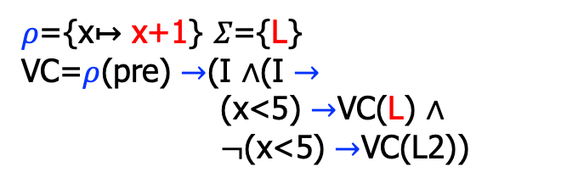
Example
{x<=0}
f(x){
L:
inv {x<=5}
if(x<5, L1, L2)
L1:
x = x+1
goto L
L2:
return x;
}
{result==5}
$ρ$={x↦ x+1} 𝛴={L}
VC=$ρ$(pre) $→$(I ∧(I $→$
(x<5) $→$VC(L) ∧
$¬$(x<5) $→$VC(L2))
pc
For a goto, jump.

Slide 46
Example
{x<=0}
f(x){
L:
inv {x<=5}
if(x<5, L1, L2)
L1:
x = x+1
goto L
L2:
return x;
}
{result==5}
$ρ$={x↦ x+1} 𝛴={L}
VC=$ρ$(pre) $→$(I ∧(I $→$
(x<5) $→$VC(L) ∧
$¬$(x<5) $→$VC(L2))
pc
For a label, continue.

Slide 47
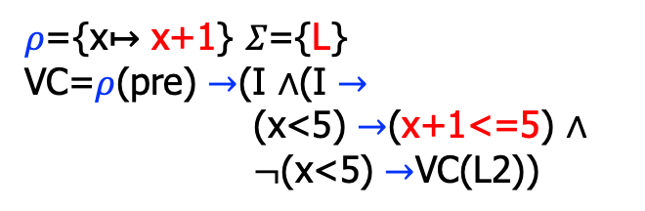
Example
{x<=0}
f(x){
L:
inv {x<=5}
if(x<5, L1, L2)
L1:
x = x+1
goto L
L2:
return x;
}
{result==5}
$ρ$={x↦ x+1} 𝛴={L}
VC=$ρ$(pre) $→$(I ∧(I $→$
(x<5) $→$(x+1<=5) ∧
$¬$(x<5) $→$VC(L2))
pc
We see the invariant inv a second time, just apply the symbolic store on the invariant.
Notice that this branch is finished!

Slide 48

Example
{x<=0}
f(x){
L:
inv {x<=5}
if(x<5, L1, L2)
L1:
x = x+1
goto L
L2:
return x;
}
{result==5}
$ρ$={x↦ x+1} 𝛴={L}
VC=$ρ$(pre) $→$(I ∧(I $→$
(x<5) $→$(x+1<=5) ∧
$¬$(x<5) $→$VC(L2))
For an label, just continue.
pc

Slide 49
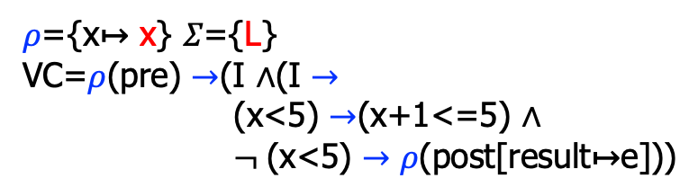
Example
{x<=0}
f(x){
L:
inv {x<=5}
if(x<5, L1, L2)
L1:
x = x+1
goto L
L2:
return x;
}
{result==5}
$ρ$={x↦ x} 𝛴={L}
VC=$ρ$(pre) $→$(I ∧(I $→$
(x<5) $→$(x+1<=5) ∧
$¬$(x<5) $→ρ$(post[result↦e]))
For return, apply the post-condition.
Pay special attention to the symbolic memory state!
pc

Slide 50
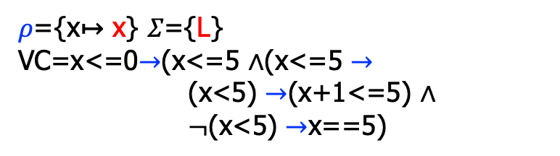
Example
{x<=0}
f(x){
L:
inv {x<=5}
if(x<5, L1, L2)
L1:
x = x+1
goto L
L2:
return x;
}
{result==5}
$ρ$={x↦ x} 𝛴={L}
VC=x<=0$→$(x<=5 ∧(x<=5 $→$
(x<5) $→$(x+1<=5) ∧
$¬$(x<5) $→$x==5)
pc

Slide 51
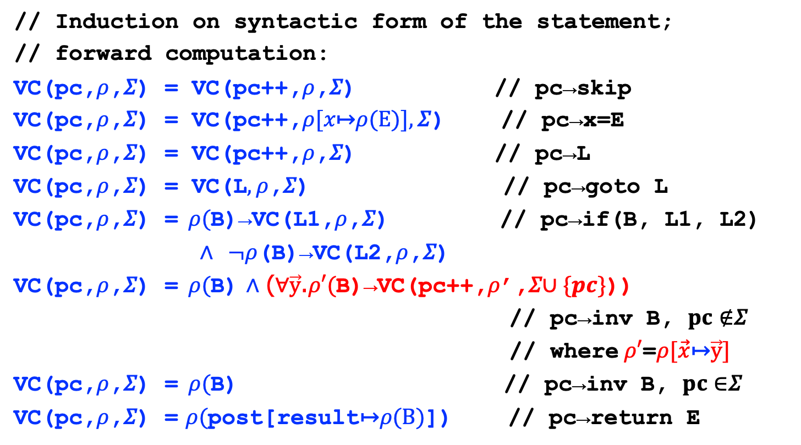
Verification Generation Rules
// Induction on syntactic form of the statement;
// forward computation:
VC(pc,$ρ$,𝛴) = VC(pc++,$ρ$,𝛴) // pc→skip
VC(pc,$ρ$,𝛴) = VC(pc++,$ρ[x\text{↦}ρ\text{(}\text{E}\text{)}],\text{Σ}$) // pc→x=E
VC(pc,$ρ$,𝛴) = VC(pc++,$ρ$,𝛴) // pc→L
VC(pc,$ρ$,𝛴) = VC(L$, ρ$,𝛴) // pc→goto L
VC(pc,$ρ$,𝛴) =$ρ($B)→VC(L1,$ρ$,𝛴) // pc→if(B, L1, L2)
∧ $¬ρ$(B)→VC(L2,$ρ$,𝛴)
VC(pc,$ρ$,𝛴) =$ρ($B) ∧ (∀$\vec{y}$.$ρ′($B)→VC(pc++,$ρ$’,𝛴$∪\{pc\}$))
// pc→inv B, $pc∉$𝛴
// where$ρ′$=$ρ[\vec{x}\text{↦}\vec{y}]$
VC(pc,$ρ$,𝛴) =$ρ($B) // pc→inv B, $pc∈$𝛴
VC(pc,$ρ$,𝛴) = $ρ($post[result$\text{↦}ρ\text{(}\text{B}\text{)}$]) // pc→return E

Slide 52

Verification Generation Rules
// For function:
VC(pre f($\vec{x}$){S*} post) = ∀$\vec{y}$.$ρ$(pre) → VC(pc==0,$ρ$,$∅$)
where $ρ$=$[\vec{x}\text{↦}\vec{y}]$

Slide 53
Summary
We discussed weakest pre-conditions and verification conditions
  And functions to calculate them
Once deemed impractical, but now widely used due to the improvement of theorem provers/solvers
  many successful applications

